Slide 1
Desks and Derricks: State of the Industry
September 23, 2022
Andrew Ritter Jr.
VP – Legislative & regulatory affairs, appalachia.
Notes:
Welcome/Self Introduction
Presentation overview and how a GR person like myself will approach a conversation like this: How I discuss the same topic with policymakers – in the big picture based on myth vs. reality.
Myth v. Reality.

Slide 2
State of the Industry – Global Energy Consumption
2.09% Average Growth Per Year
Notes:
Part 1: Global Energy Consumption
50 year picture – the hunger for energy globally is high and is consistently increasing.
Part 2: It is a reflection of economic development and advancement
Without spending a lot of time on this point – just look at global energy consumption during global recessionary periods
Part 3: Nonetheless – the growth is consistent over time and the direction is clear
Part 4: Who is consuming the energy?
This is a view of that previous chart broken down by continent. Every continent, except Europe, is seeing significant growth – albeit at different scales.
Specifically note North America, Asia, Africa, and South America

Slide 3
State of the Industry - What is Fueling This Demand?
It takes approximately the same amount of energy to make a smartphone as it does a refrigerator.
EVERYTHING
You can’t make something, move something, or grow something without energy.
10x More Produced Annually
The average refrigerator weighs 1,000x more than the average smartphone.
WSJ, August 26, 2022
Notes:
What is fueling this demand?
Discuss the reality of energy – needed for absolutely everything where an economy exists and needed in every aspect of these economies.
Discuss economic development and developing economies
But its not just countries going through industrialization, it is also industrial countries – and other developing economies – going through technological revolutions.
I won’t take time to go into every aspect of this, but I have one example I recently came across that really highlights how energy intensive developed economies are and how energy intensive the technological revolution is.
Discuss refrigerator vs. smartphone comparison and energy use.
Tech sector energy use – 3rd largest country reference (Tinker)

Slide 4
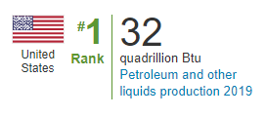
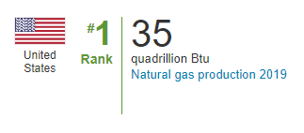
State of the Industry – Do We Need a Global Energy Transition?
Energy
Transition?
Addition
U.S. Energy Information Administration
Notes:
Jump back to the global consumption chart
Ask the question about an energy transition. Approaching a tripling of energy consumption in the last 50 years. This is mostly coal, gas, and nuclear. Is an energy transition practical? Is it possible? Really smart people write a lot about these questions. I’m not one of those really smart people – but when I see a chart like this, I draw one conclusion….
The focus in energy development and policy shouldn’t be about a transition – and I don’t say that to discourage new energy sources, be it wind, solar, hydrogen, etc. Instead, it should be about energy addition.
This is a myth v. reality moment. If you are talking to someone who isn’t talking about energy addition, I’d submit you aren’t in a serious, realistic conversation. You are in a mythical discussion.
The American oil and gas industry has consistently met the moment when it comes to energy addition. That is the companies you work for - - and yes you as individuals with those companies.
It is thanks to each of you and the companies you work for that America is the #1 producer of petroleum and the #1 producer of natural gas … in the world. This is another myth vs. reality moment. We hear so many individuals and organizations say we have to end oil and gas production and use and they aren’t needed. Look one more time at this chart. The reality is we are needed now more than ever – and there is no reason to believe that need will change anytime soon.

Slide 5
State of the Industry: America’s Response to the Need for Increased Energy?
January 20, 2021
Keystone XL Pipeline Cancelled
ANWR Production Restrictions
January 27, 2021
Moratorium on New Leases on Public Lands
Reconsideration of Permitting Practices
Directive to Eliminate Fossil Fuel “Subsidies”
February 19, 2021
Rejoined the Paris Climate Agreement
February 23, 2021
Curtailed Energy Production on Federal Lands
March 15, 2021
Sought Input on Potential SEC Rule on GHG Disclosures
April 15, 2021
FERC Policy to Accommodate Carbon Pricing in Electricity Markets
April 16, 2021
DOI Revokes Policies Establishing “American Energy Independence” as a Goal
April 22, 2021
US International Climate Finance Plan to Direct International Financing Away from Oil and Gas
May 28, 2021
Proposed FY2022 Budget Including $150 billion in Tax Increases on Oil and Gas Producers
August 11, 2021
Letter Asking OPEC+ to Produce More Oil
October 7, 2021
Revoked NEPA Reforms
October 28, 2021
Congress Attacks Oil CEOs for Increasing Production While Europe Lowers Production
October 29, 2021
BLM Incorporates “Social Cost of Carbon” in Permit Approvals
October 30, 2021
DOL Issues ESG Rule Requiring Funds/Pension Plans to Consider Economic Effects of Climate Change in their Investment Policies
November 2, 2021
US Leads Global Methane Pledge – Neither Russia nor China Participates
November 12, 2021
EPA Proposes New Source Rule (Methane)
November 19, 2021
Endorses $1500/ton Methane Tax Among Other Taxes/Restrictions
November 26, 2021
DOI Recommends Raising Rents/Royalty Rates on Oil and Gas Producers on Federal Lands
February 21, 2022
Paused New Oil and Gas Leases on Federal Land in Response to Adverse Judicial Decision
March 21, 2022
SEC Proposes Mandatory Climate Disclosure Rule
April 21, 2022
US Climate Envoy Kerry Says World Reliance on Natural Gas Should Last No More than a Decade
Selected Actions from the American Energy Alliance
Notes:
So if we are the leading country in oil and gas production and the world needs more energy – it would seem logical that the policies we enact in our country would be to support the oil and gas industry to allow us to continue to meet this huge thirst – and growing need – for energy around the world.
But what has happened recently? The exact opposite.
This is in no way a political statement – but this – very wordy – slide is just a sampling of energy policy actions that have been taken since January 2021.
Highlight a few policy items
Unfortunately, these policy actions are indeed reality. They happened. They are in place. But they are all based on the myth we just discussed on the last slide – that we can and should aggressively end the use of fossil fuels, of oil and gas, in this country.
This myth though eventually met a stone cold reality. Because something happened around April or May of this year…and what was that?

Slide 6
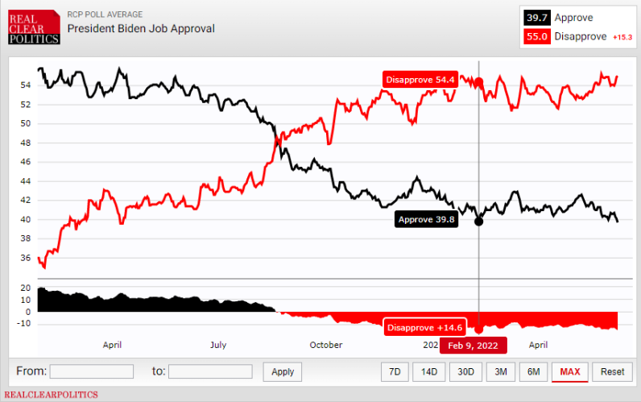
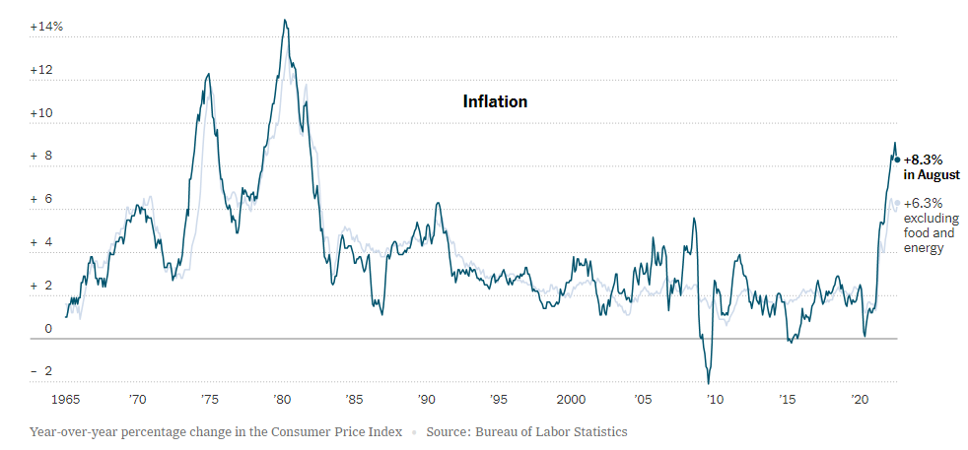
State of the Industry: Fantasy Meets Reality
Economic Reality
Political Reality
Notes:
Highlight inflation chart. Highlight it as an economic reality.
Highlight presidential approval rating chart. Highlight it as a political reality.
That eventually changed everything we saw on the last slide - - and energy policy reality entered the mix for the first time in 18 months.
This is not to say reality has been fully realized or embraced, but it was most certainly a marked turn in our recent policy direction.

Slide 7
State of the Industry: Natural Gas Meeting the Call
U.S. Energy Information Monthly Natural Gas Production Reports
Notes:
Natural gas has been doing its part – US Natural gas production is at its highest point ever.

Slide 8
State of the Industry: Air Quality
Notes:
Amazingly, as you probably already know – it has helped reduce GHG in this country and continent now for quite some time. The only other continent that can say that is Europe – but as noted earlier – this is for very different reasons.
The Economic and environmental miracle of our lifetimes (flip back and forth between the two slides).

Slide 9
State of the Industry: Conclusion
Notes:
Close by asserting the importance of us appreciating and sharing reality and facts – and not being distracted by the myths.
American oil and gas will continue to be the backup power for solar and wind as it is built.
American oil and gas will still be the feedstock for the components of the electric vehicles being deployed on our highways.
American oil and gas will still continue to fuel the new baseload power generation facilities being built across this country as older facilities are retired.
American oil and gas will still help meet the energy demand of the world as economies develop and as industrial and technological revolutions continue across the globe.
And American oil and gas will still continue to be produced in a cleaner, more environmentally responsible way than anywhere else in the world.
You can’t go wrong with that reality.
Thank you all for having me.

