Slide 1
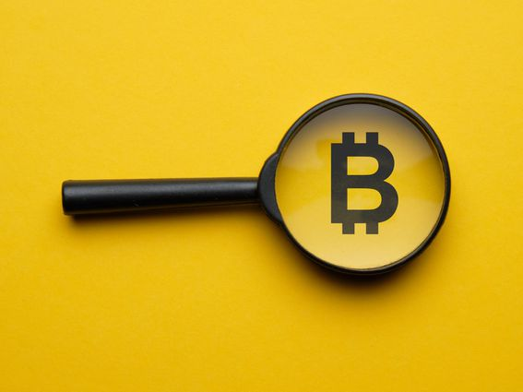
BITCOIN 101
By: Mark Easton

Slide 2
Bitcoin’s Beginning and Founders
Bitcoin was created on January 3, 2009 following the 2008 financial crisis.
“ I’ve been working on a new electronic cash system that is fully peer to peer, with no trusted third party.” -Satoshi Nakamoto
Satoshi Nakamoto - Bitcoin Founder Wei Dai - B Money
Hal Finney - Renewable Proof of Work Pioneer Julian Assange - Wikileaks
David Chaum - DigiCash Phil Zimmermann - PGP (Pretty Good Privacy) Encryption
Nick Szabo - Bit Gold John Gilmore - Cypherpunk Mailing List
Adam Beck - HashCash Tim C. May - Cypherpunk Mailing List

Slide 3
What is Bitcoin?
Bitcoin is an electronic cash system that is fully peer to peer.
Bitcoin does not require a third party, or trust of any entity to verify it’s transactions.
All transactions are public and processed by computers using “Blockchain” technology.
Bitcoin wallets are fully encrypted to ensure the wallet owners remain anonymous.
Bitcoin is a self custodial asset that cannot be recreated or destroyed.
Bitcoin functions on a decentralized network that will always work as long as there are Miners and Internet.
Bitcoin is designed to be a store of value much like a digital gold.

Slide 4
How Bitcoin Works
Bitcoin has a consensus method called “Proof of Work.”
Proof of work is a consensus method that uses Computers Miners and Electricity to process all the transactions.
Every bitcoin will always be kept on the blockchain, the users will only have possession of their private keys. This is how the blockchain can keep track of every transaction and every bitcoin.
Bitcoin’s Ledger keeps track of every transaction on the blockchain forever. The blockchain keeps track of the wallet sending the bitcoin, the wallet receiving the bitcoin, and the amount of bitcoin sent. The transactions remain anonymous because every wallet is encrypted on the blockchain so the owner of the wallet remains unknown but the transaction is perfectly visible on bitcoin’s ledger.
As long as there is internet and Bitcoin miners, Bitcoin can not be neutralized, shut down, or stopped.
Bitcoin the asset is created in exchange for the electricity used to mine the bitcoin, this ensures a certain amount of value that can not be duplicated or destroyed.

Slide 5
How to Get Bitcoin and Use Bitcoin
Most commonly people are purchasing bitcoin through a centralized exchange such as Coinbase Pro.
Once you purchase your bitcoin you can then withdrawal it and send it to another exchange or wallet.
You can use bitcoin to purchase almost every other cryptocurrency.
You can use bitcoin as legal tender in several countries, states, and cities around the world.
You can always send it to a friend or family member.
You can send it back to an exchange and swap it for any local currency.

Slide 6
Bitcoin’s Tokenomics
How many Bitcoins are in circulation today? 19,156,031
When will the last Bitcoin be Mined? Year 2140
How Many Bitcoins will there be in total? 21 Million
Bitcoin breaks down into how many units? 100,000,000
What's the smallest unit of Bitcoin called? A Satoshi (1/100,000,000 of a bitcoin)
How are the Bitcoin’s introduced into the blockchain? The Miners are creating the bitcoin on a predetermined schedule.

Slide 7
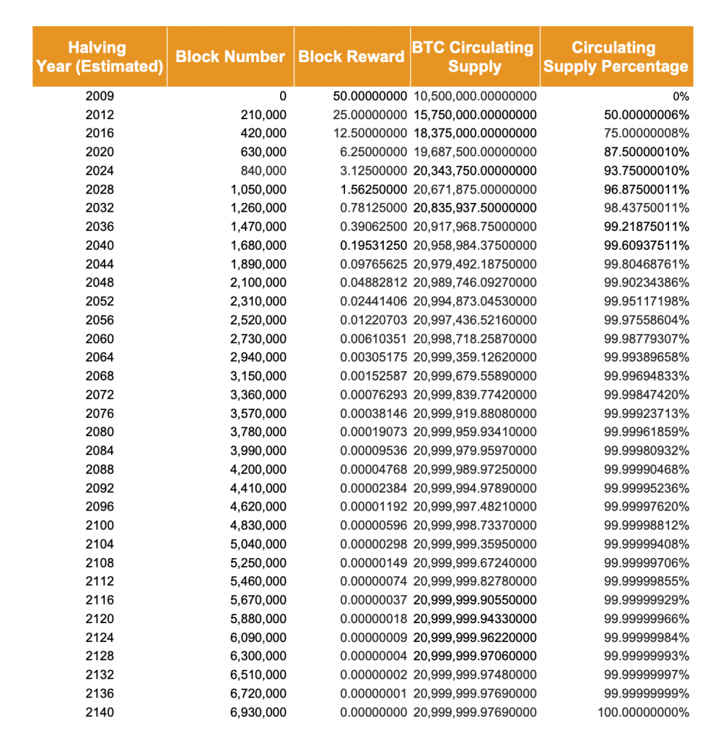
Bitcoins Schedule

Slide 8
How is Bitcoin Regulated
In the United States of America, Bitcoin is classified as an asset not a currency.
Sales of bitcoin must be recorded on tax returns.
Buying and selling Bitcoin is subject to Capital Gains Tax.
Owning a bitcoin without debt is equivalent to owning a house, building, or land without debt.
There are plenty of lenders that will lend you up to 80% of the value of your bitcoin, if locked up as collateral.
Most investors that have appreciating assets will put loans on their assets rather than selling them when they need funds.

Slide 9
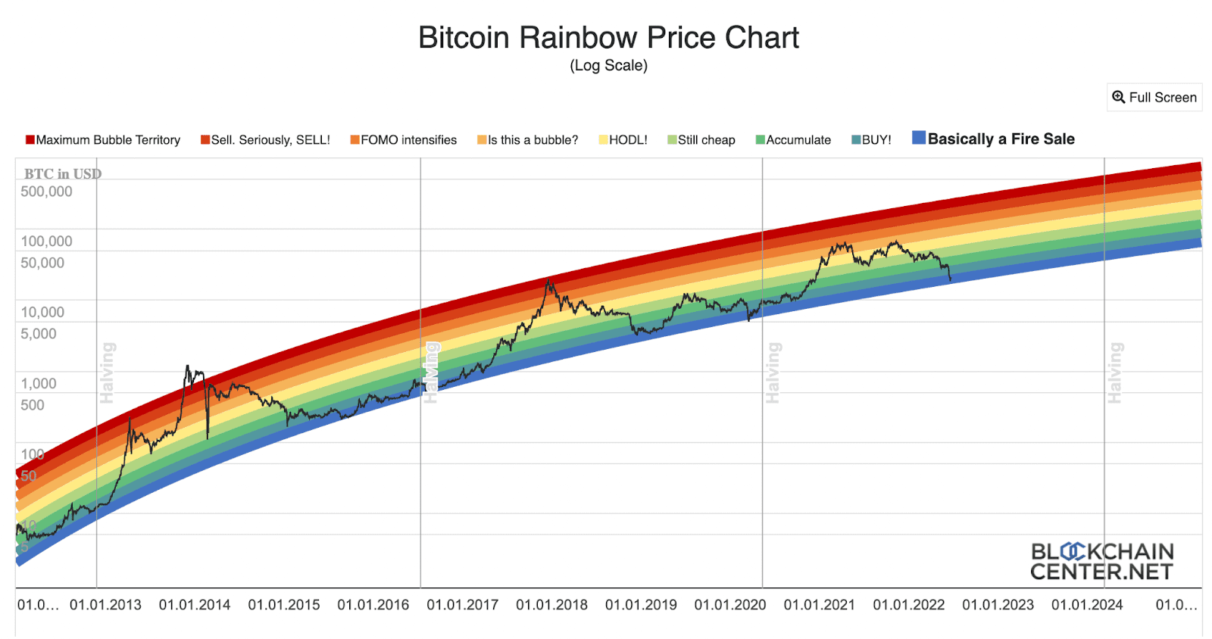
Bitcoin as an Investment
Bitcoin is a volatile asset in the short run.
Holding Bitcoin over the long run proves to be a good investment.

Slide 10
The Power of Bitcoin
You can bring your bitcoin across any border as you travel. On public flights, cash is limited to $10,000 or needs declared. Bitcoin wallets can hold Billions of dollars in your pocket.
Bitcoin can be exchanged into any currency on the planet.
Bitcoin will remain a scarce asset unlike Gold and Dollars that has a supply that endlessly grows.
Bitcoin will not have the problem of inflation like most other currencies.
Having an asset you can take with you to any country in the world, provides a sense of security that no government can take away from you. Investing in real estate is not protected from government decisions. Example: Property owners in Venezuela were punished due to government decisions.
Bitcoin is an asset that you can liquidate immediately. Real estate and other assets could take months or years to liquidate.
You can easily send 1 Billion dollars worth of bitcoin for a couple dollars without the approval of any government or centralized bank, all while staying anonymous.
The Bitcoin network runs 24 hours a day 365 days a year.
Bitcoin’s network is extremely secure due to the decentralized design.

Slide 11
Bitcoin vs USD and Gold
Large amounts of USD and Gold are typically stored in the possession of Centralized Banks and other Treasuries.
Bitcoin keys are stored in your personal possession in a very light weight crypto wallet.
Traveling with abundance of USD and gold proposes much greater challenges compared to a small bitcoin wallet.
Gold and USD can be stolen from your possession. Stealing a crypto wallet does not give you access to the bitcoin.
Losing your crypto wallet is not an issue because funds can be recovered. Losing USD and gold, it’s gone forever.
Supply of bitcoin will never surpass 21 million bitcoin. USD and Gold are being created daily which reduces their value.
In the past 10 years the value of USD has decreased by 35%. In 2012 your 1 dollar invested in now worth 1 dollar, but the purchasing power is equivalent to 65 cents.
In the past 10 years the value of gold has increased by 9.7%. In 2012 your 1 dollar invested in gold is now worth 1.10 dollars. (A loss given inflation of 35%)
In the past 10 years Bitcoins value has increased 153,366%. In 2012 your 1 dollar invested in bitcoin is now worth $1,534

Slide 12
Bitcoin Notes to Remember
Not your Keys, Not your Crypto. (Never leave your crypto on exchanges. Always send your bitcoin to cold storage crypto wallets)
Be cautious of scammers trying to get access to your wallet. Never give away your seed phrase.
Bitcoin has been pronounced dead over 400 times since its creation by bankers, financial institutions and the media.
Governments and Banks will continue to give bitcoin a bad reputation simply because they cannot control it.
Owning Bitcoin is perfectly legal in the United States because it is a legal taxable asset.
Stay more focused on the fundamentals of Bitcoin and less on the price action.
Understand Bitcoin is not like a typical good, in fact quite the opposite, it’s considers a veblen good. A veblen good is an economic term to describe a good that is more desired when the price is higher, and the lower the price is, the less people want to buy it.
My Investment Strategy: If you never felt so rich and you want to tell all your friends to buy bitcoin, SELL! If you feel sick to your stomach because you never lost so much money, BUY!
Please remember I am not a financial advisor and nothing I have said today should be considered financial advice.

Slide 13
Thank you to Range Resources for the invitation to speak about Bitcoin
Feel free to contact me anytime if you need help investing or understanding cryptocurrencies.
-Mark Easton
Mark@buccosroofing.com

