Slide 1
ADDC Memorial 2019-2022
In Memory of Our Lost Members

Slide 2
ADDC Memorial 2022
Central Region

Slide 3
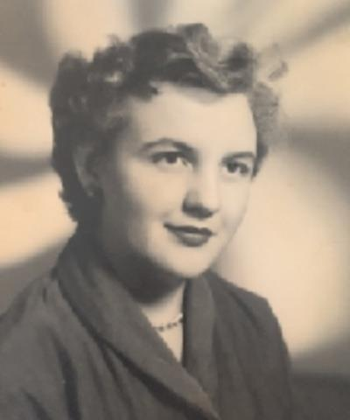
DESK AND DERRICK CLUB OF DALLAS
DOROTHY EVELYN
ROBERTS LYLE
AUGUST 1933 to APRIL 2019
FORMER MEMBER OF
DALLAS CLUB
1997 DALLAS CLUB PRESIDENT
FORMER MEMBER OF REGION IV

Slide 4
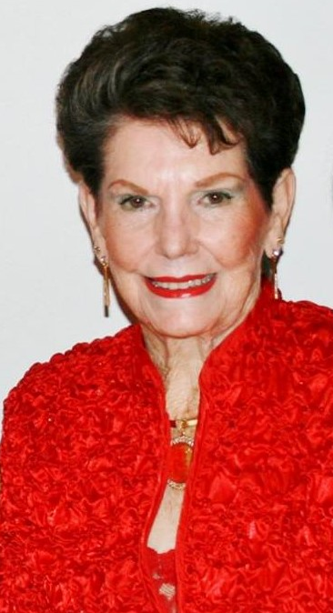
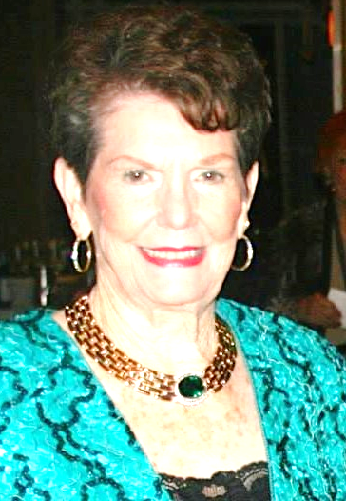
THE LONE STAR
DESK AND DERRICK CLUB OF
DALLAS, TEXAS
GRETA McMICHAEL
MAY 1933 to APRIL 2021
53 YEAR MEMBER
MEMBER OF SHREVEPORT & DALLAS DESK AND DERRICK CLUBS AND CHARTER MEMBER OF THE LONE STAR CLUB OF DALLAS

Slide 5
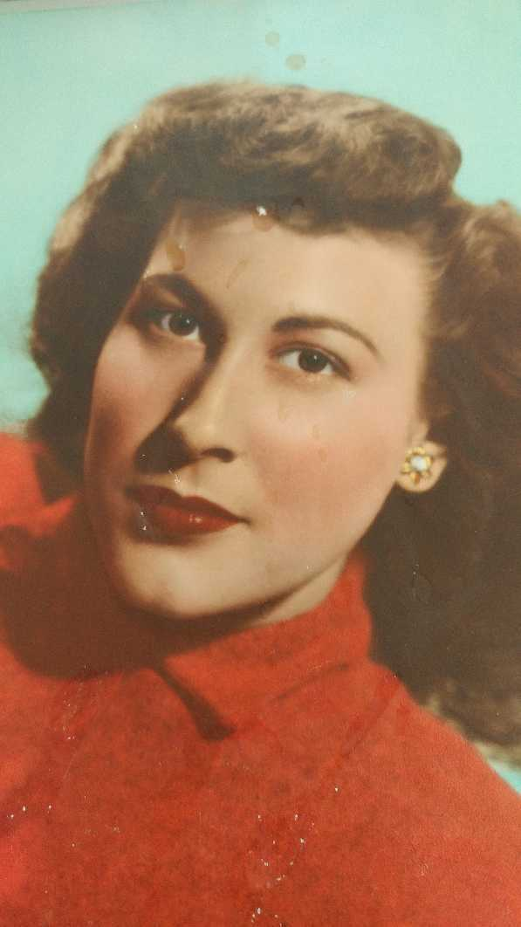
THE LONE STAR
DESK AND DERRICK CLUB OF
DALLAS, TEXAS
DIMPLE L. ZEIGER
DECEMBER 1927 to AUGUST 2021
53 YEAR MEMBER
MEMBER OF DALLAS CLUB AND CHARTER MEMBER OF
THE LONE STAR CLUB
PRESIDENT OF DALLAS CLUB
1978 REGION IV DIRECTOR

Slide 6
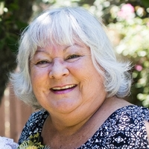
DESK AND DERRICK CLUB OF
OKLAHOMA CITY, OKLAHOMA
EVELYN PEARL SMITH
APRIL 1953 to SEPTEMBER 2021
16 YEAR MEMBER

Slide 7
DESK AND DERRICK CLUB OF TULSA
PEGGY ANN FERRELL
AUGUST 1937 to DECEMBER 2020
43 YEAR MEMBER

Slide 8
ADDC Memorial 2022
Northeast Region

Slide 9
Life and death happen regardless of COVID and that was the case for Robert M. Jarrett who was a member of Penn York Oil & Gas Affiliates.

Slide 10
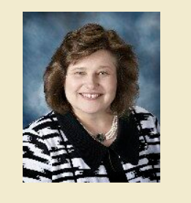
DESK AND DERRICK CLUB OF Heartland Southern Illinois
Kimberly Oelze, 63, of Nashville, IL, born June 4, 1959, in Belleville, IL, passed away Monday, July 25, 2022, in Belleville, IL.

Slide 11
PENN YORK OIL AND GAS AFFILIATES
DESK AND DERRICK CLUB
DANIEL V. PALMER
NOVEMBER 1960 to FEBRUARY 2021
10 YEAR MEMBER

Slide 12
ADDC Memorial 2022
Southeast Region

Slide 13
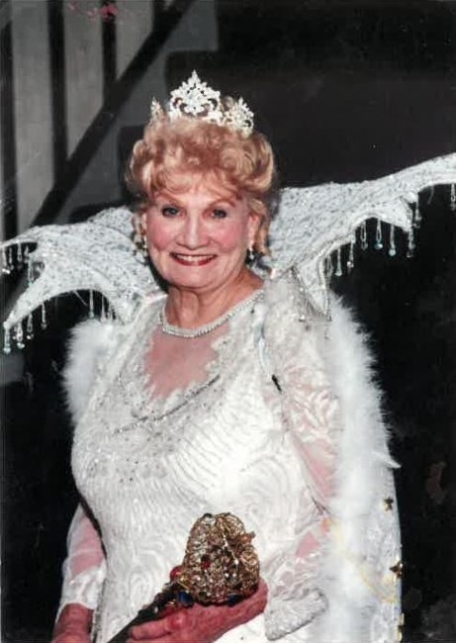
Baton Rouge
Lila Latimer Carbo
August 31, 1929 – February 24, 2021
Retired from the LA State Mineral Board
Designed many ball gowns for club events and served as 2001 Queen of the Mardi Gras Ball
Received Governor’s Award from Governor Edwin Edwards for dedicated service to the State of Louisiana

Slide 14
Lafayette Club
Margaret Badeaux
Passed away August 31st at the age of 85
Past president of Lafayette Club 1988

Slide 15
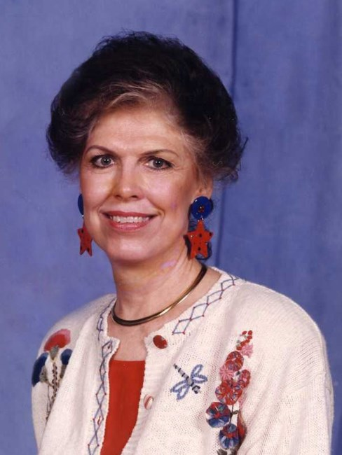
El Dorado
Freda Acton
June 27, 1931 – April 3, 2019
Lion Oil employee for 51 years and 8 days
Deeda and Alfred were Challenge Level Square Dancers
Member of ADDC for over 45 years
Avid gardener and traveler

Slide 16
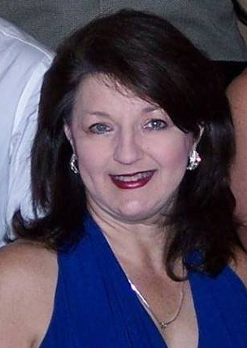
El Dorado
Jana Hazelwood
October 20, 1960 – July 5, 2021
Member since 2009
Served as Club President
Loved planting flowers and sewing

Slide 17
Lafayette
Linda Perry Wilson
December 10, 1949 – April 13, 2020
Proud CEO and founder of A1 Professional Answering Service.
Petroleum Club of Lafayette Board of Directors

Slide 18
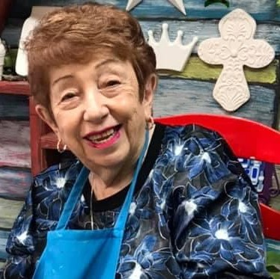
New Orleans
Daisy Lee Laporte
March 6, 1938 - December 17, 2020
1977 Club President
1979 Region III Director
Exxon Mobil legal secretary
Loved the Saints and Mardi Gras

Slide 19
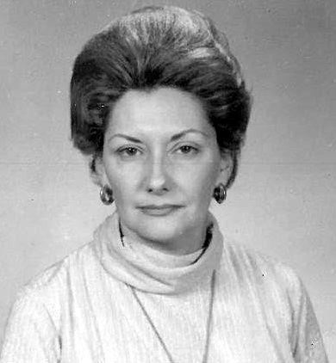
New Orleans
Pamela Joan Meldrum
June 3, 1936 – June 22, 2020
Attended McMahon Business College in Houston, TX
Long-time member of the New Orleans Club.

Slide 20
Red River
Deb McCuller
August 26, 1963 – January 9, 2021
Club officer
“Gusher” editor for 12 years
Loved Jesus, Dallas Cowboys, LSU Football, and vacations with the Baker family

Slide 21
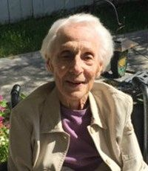
Victoria
Edna “Marie” Gummelt
March 4, 1923 – July 19, 2019
Past Region IV Director
Past Club President
Attended Baldwin’s Business College in Yoakum, TX
Stayed in touch through club newsletters even after moving out of the area

Slide 22
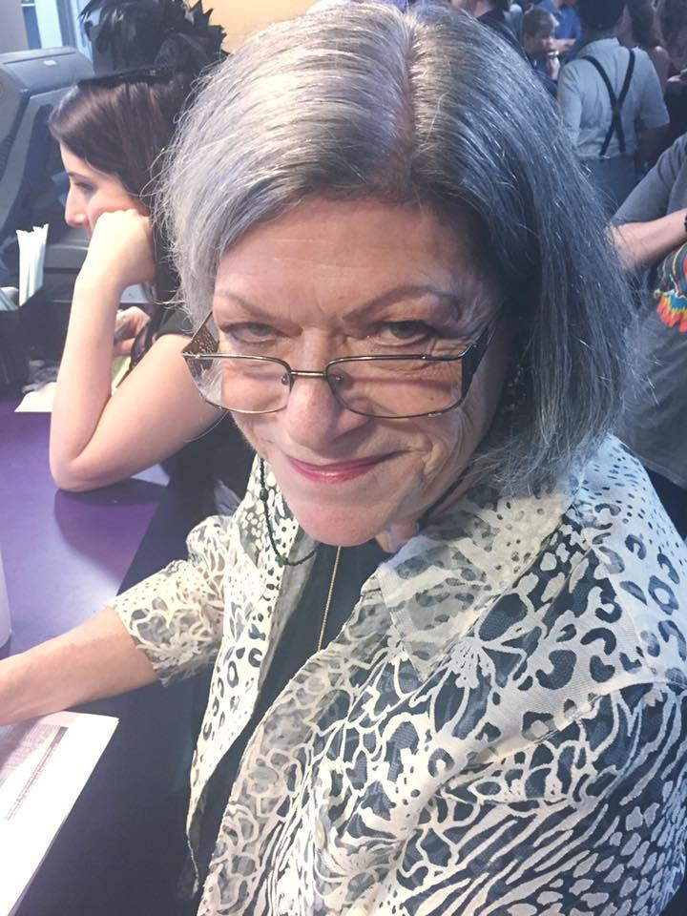
Westbank
Robbye St. Pierre
January 27, 1951 – December 2, 2019
Warexco – family business with husband Warren
Valued member of Westbank Optimists Club as well as the Desk and Derrick Club of the Westbank
Adventures with her family and friends filled her free time

Slide 23
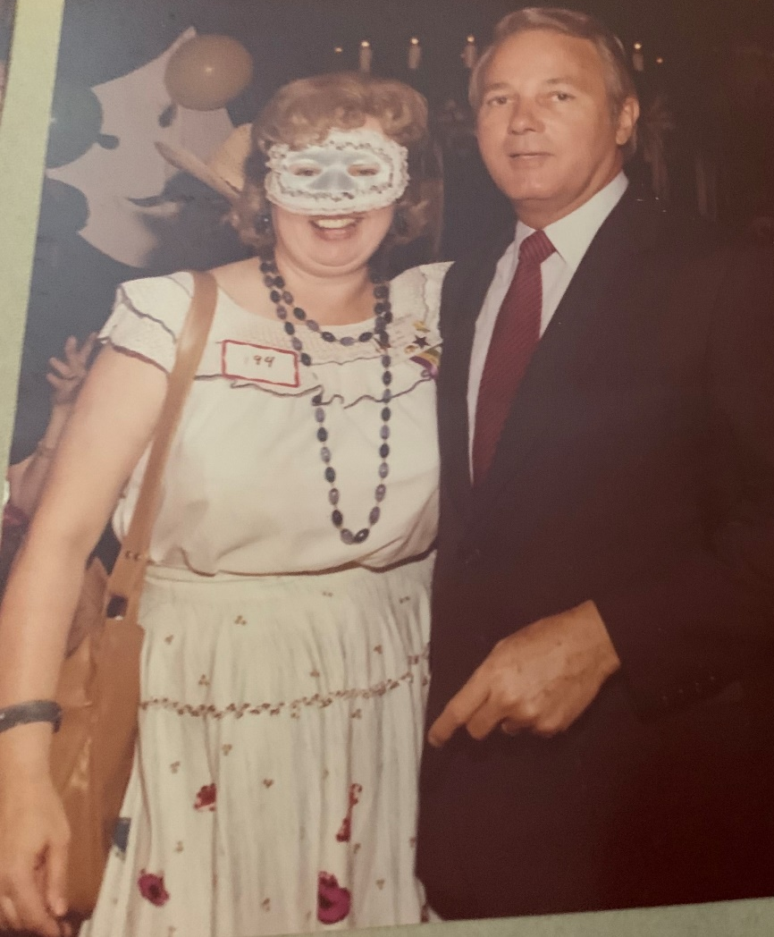
Westbank
Hilda Wood
December 13, 1932 – November 1, 2021
Desk and Derrick Member for 45 years
30-year career as an executive secretary with Exxon Mobil
Ballroom dancing was her favorite pastime

Slide 24
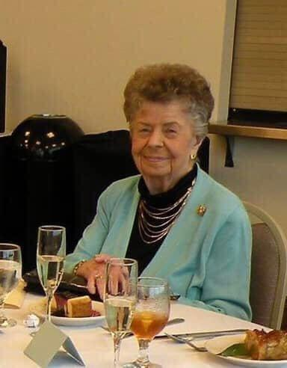
Beverly "Bev" George, age 97, passed away peacefully in her home on the evening of July 25, 2022.
DESK AND DERRICK CLUB OF New Orleans

Slide 25
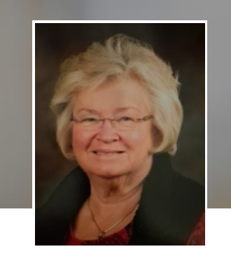
Linda Lou Krech Passed away July 23, 2022 at the age of 74.
DESK AND DERRICK CLUB OF TRI-STATE

Slide 26
ADDC Memorial 2022
West Region

Slide 27
FARMINGTON DESK AND DERRICK CLUB
RAMONA STAGNER
March 1956 - June 2021
7 YEAR MEMBER
VERY ACTIVE UNTIL
RELOCATION TO BAKERSFIELD

Slide 28
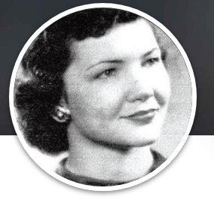
Donna Carol Germany Cofer, 84, of Pampa, passed away peacefully on Friday, August 19, 2022 at her home.
DESK AND DERRICK CLUB OF Pampa

Slide 29
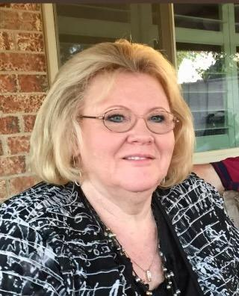
DESK AND DERRICK CLUB OF MIDLAND
LINDA DONHAM
1953 to DECEMBER 2020
30 YEAR MEMBER
VERY ACTIVE MEMBER

Slide 30
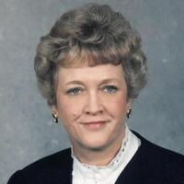
DESK AND DERRICK CLUB OF PAMPA, TEXAS
TERRESA GAILE SNOW
MAY 1940 to SEPTEMBER 2021
42 YEAR MEMBER
VERY ACTIVE MEMBER

Slide 31
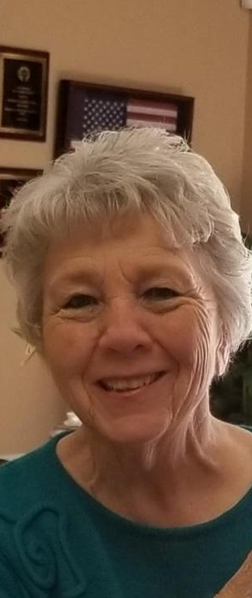
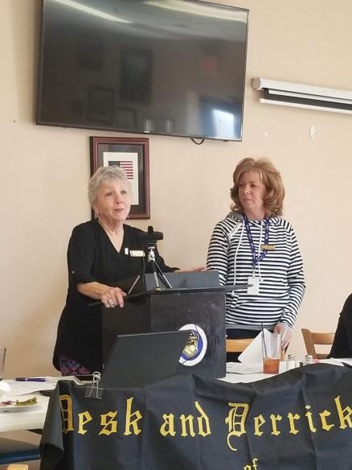
DESK AND DERRICK CLUB OF Roswell, NM
Robbie Jo Powell
Passed Away 7/5/2022
Joined in 1974

Slide 32
FORMER MEMBERS & Supporters OF DESK AND DERRICK CLUBS

Slide 33
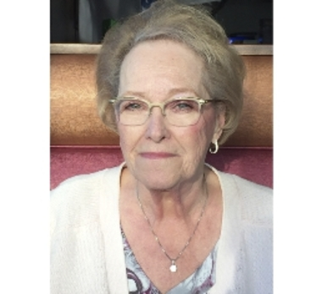
DESK AND DERRICK CLUB OF EDMONTON, ALBERTA, CANADA region vii
LYNNE DUNSTAN
DECEMBER 1944 to JANUARY 2021
1993 CLUB PRESIDENT
2010 REGION VII DIRECTOR
CANADIAN OILWOMAN OF YEAR

Slide 34
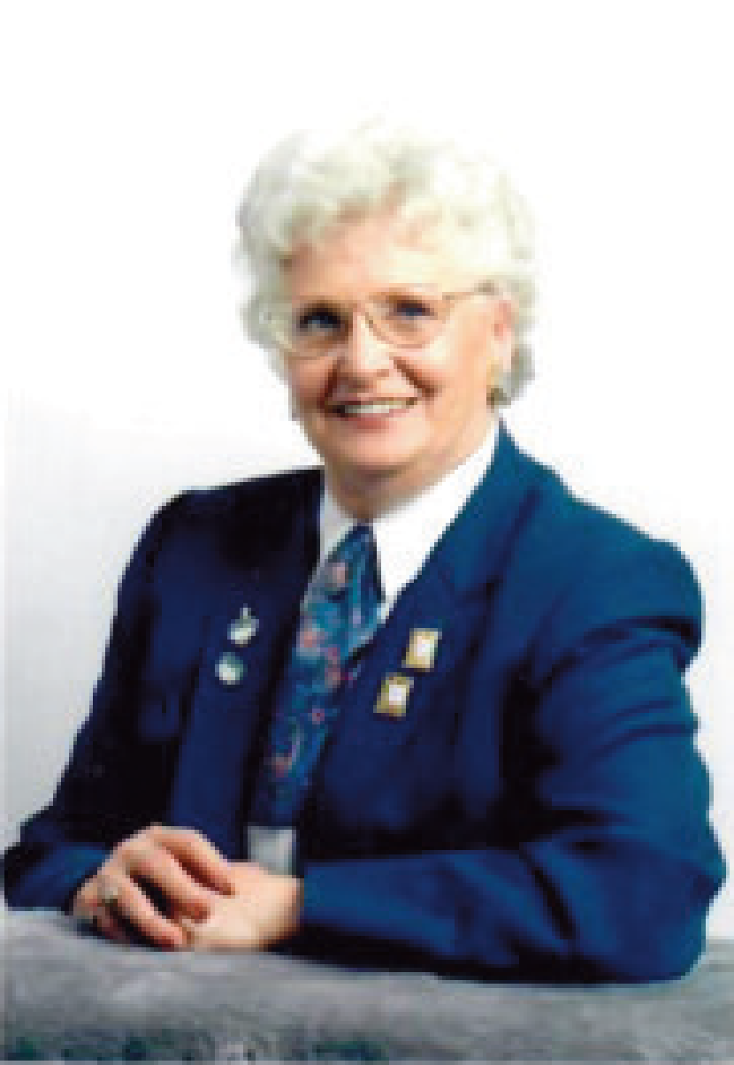
DESK AND DERRICK CLUB OF EDMONTON, ALBERTA, CANADA region vii
DOROTHY HARRIS
JULY 1931 to MAY 2021
CLUB PRESIDENT 1976 AND 1985
CANADIAN OILWOMAN OF YEAR
1998 INDUCTED INTO THE CANADIAN PETROLEUM
HALL OF FAME

Slide 35
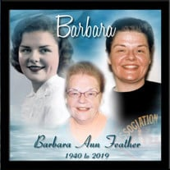
DESK AND DERRICK CLUB OF BALTIMORE, MD
Region i
BARBARA ANN FEATHER
June 1940 to OCTOBER 2019
PRESIDENT OF BALTIMORE CLUB
1983 REGION I DIRECTOR

Slide 36
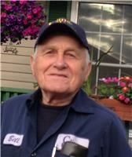
PENN YORK OIL AND GAS AFFILIATES
DESK AND DERRICK CLUB
Northeast region
WILLARD “BILL” CLINE
SEPTEMBER 1925 to DECEMBER 2020
SPONSOR OF PYOGA CLUB FOR MANY YEARS

Slide 37
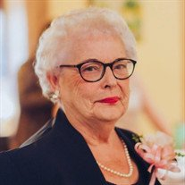
DESK AND DERRICK CLUB OF TYLER, TEXAS
Region iv
PEGGY JO MCMILLAN
JANUARY 1936 to JANUARY 2021
46 YEAR MEMBER
1980 CLUB PRESIDENT

Slide 38
Desk and derrick club of Denver &
MILE HIGH DESK AND DERRICK CLUB
Region vii
BETTY NELSON
1934 to February 2020
PRESIDENT OF MILE HIGH CLUB
1980 REGION VII DIRECTOR
MEMBER OF DENVER, MILE HIGH, HOUSTON AND
SAN ANTONIO CLUBS

Slide 39
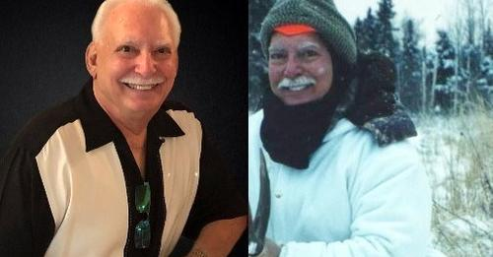
Royal R. Adams, Jr. of Harvey, Louisiana passed away on Wednesday, April 13, 2022 at the age of 78.

Slide 40
TRIBUTE TO ADDC PAST PRESIDENTS

Slide 41
Corpus Christi
Gloria Caravantes
September 18, 1921 – November 21, 2019
Employed by Exxon for 38 years
1975 ADDC President – Convention in Houston, TX
Member of Business and Professional Women’s Club

Slide 42
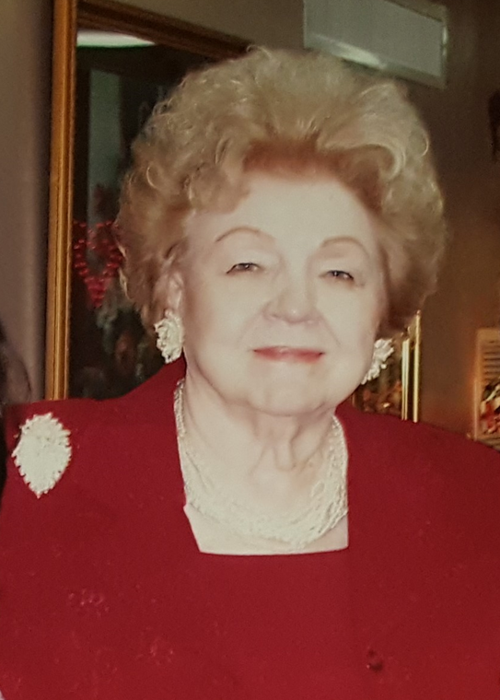
North Harris /Montgomery Counties
Lurline (Lurl) Wall Andrus
January 17, 1926 – April 14, 2019
1980 ADDC President – Convention in New Orleans, LA
An inspirational leader throughout her careers with the API and ADDC
When I get old and gray, I would rather say: “I’m glad I did rather than I wish I had.”

Slide 43
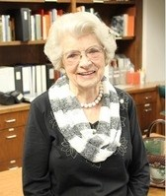
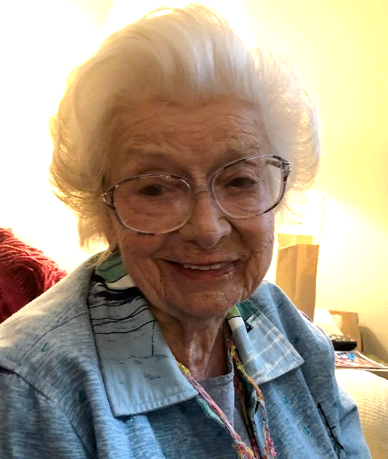
FLORIENE “FLO” MESSALL MARCH 1922 to JULY 2021 BARTLESVILLE CLUB PRESIDENT 1969 REGION VI DIRECTOR 1974 ADDC PRESIDENT
BARTLESVILLE CLUB &
REGION VI

Slide 44
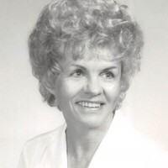
PAMPA CLUB & REGION V
MARTHA ROJEAN SUBLETT
MARCH 1931 to NOVEMBER 2020
PRESIDENT OF PAMPA CLUB
1980 REGION V DIRECTOR
1987 ADDC PRESIDENT

Slide 45
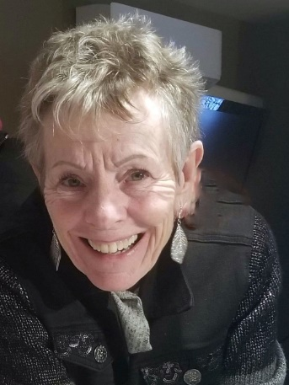
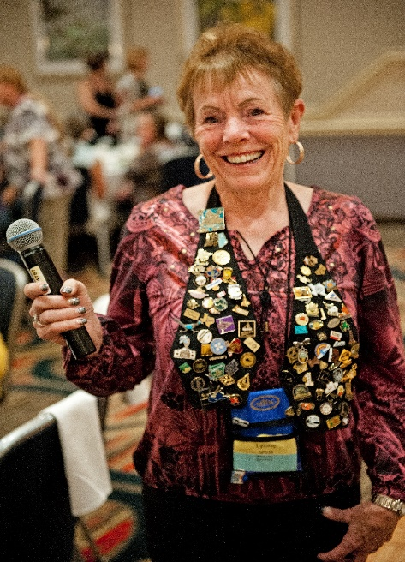
CALGARY CLUB & REGION VII
LYNNE GROSE
1946 to JANUARY 2020
MEMBER OF CALGARY AND DENVER CLUBS
PRESIDENT OF CALGARY CLUB
1989 REGION VII DIRECTOR
1994 ADDC PRESIDENT

Slide 46
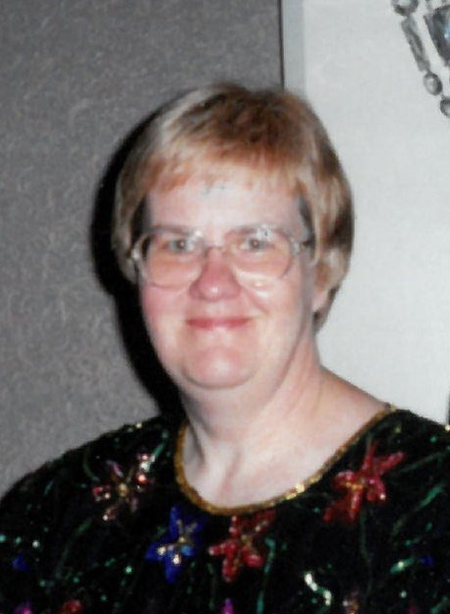
1998 ADDC President
Nancy Marie Grosskrueger, age 69, of Maplewood, Minnesota passed away on Tuesday, December 21, 2021. Nancy was born September 29, 1952.

Slide 47
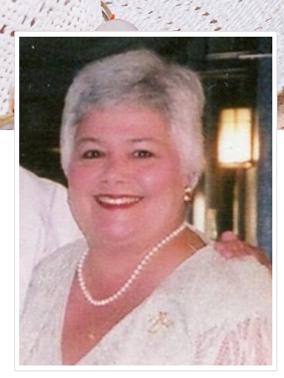
Candis Kenner Wells, age 69, of Palestine, Texas, passed away into the loving arms of Jesus on Friday, the 15th day of July 2022, with her devoted husband by her side. “Candy” as she was affectionately known, was born in Bossier City, Louisiana, on the 3rd day of June 1953, to parents Gerry Kenner and Joan Kilcrease.
DESK AND DERRICK CLUB OF Fort Worth

