Slide 1
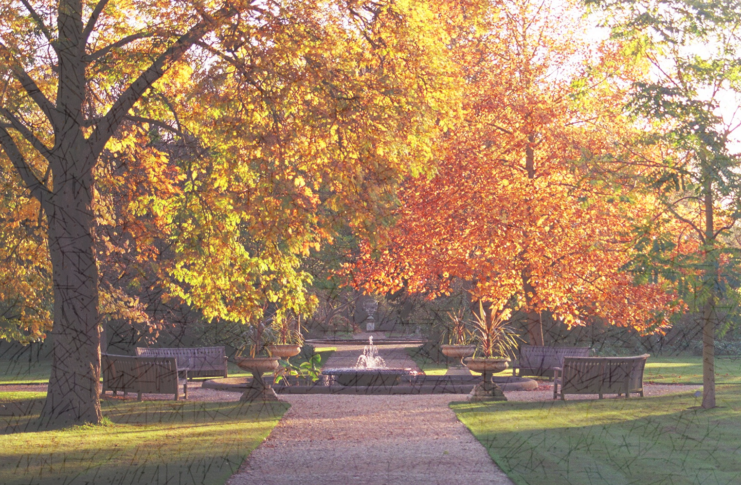
2019 ADDC CELEBRATION OF LIFE
This Photo by Unknown Author is licensed under CC BY-SA

Slide 2
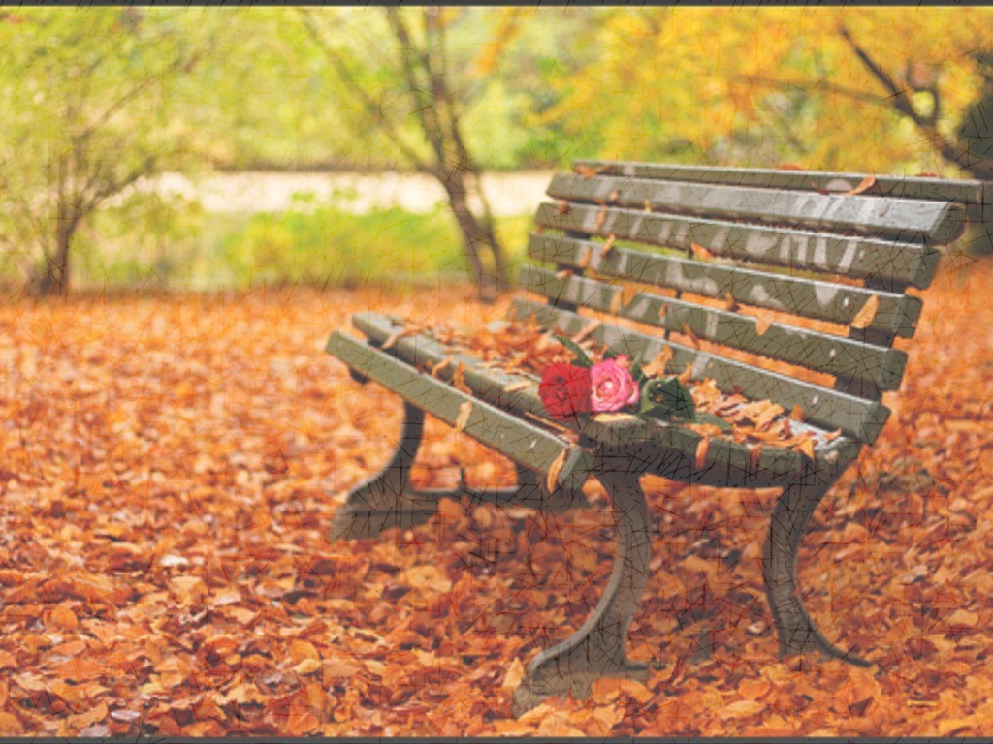
CENTRAL REGION
This Photo by Unknown Author is licensed under CC BY-NC-ND

Slide 3
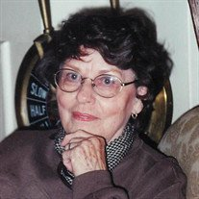
Butler county , kansas
DARLENE LEO BRUNER
SEPTEMBER 1931 TO OCTOBER 2018
MEMBER OF THE BUTLER COUNTY CLUB
FORMER MEMBER OF REGION VI

Slide 4
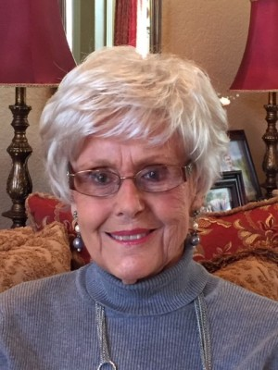
Butler county , kansas
DORIS KING
JULY 1929 TO OCTOBER 2018
MEMBER OF THE BUTLER COUNTY CLUB
FORMER MEMBER REGION VI

Slide 5
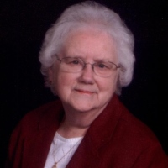
Butler county , kansas
HAZEL B. LYNCH
DIED JANUARY 2019
MEMBER OF THE BUTLER COUNTY CLUB
FORMER MEMBER OF REGION VI

Slide 6
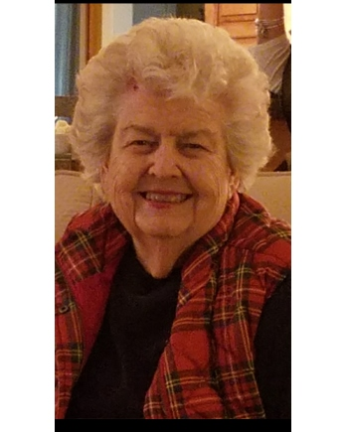
Butler county , kansas
ELEANOR SIFFORD
DECEMBER 1930 TO DECEMBER 2019
MEMBER OF THE BUTLER COUNTY CLUB
FORMER MEMBER OF REGION VI

Slide 7
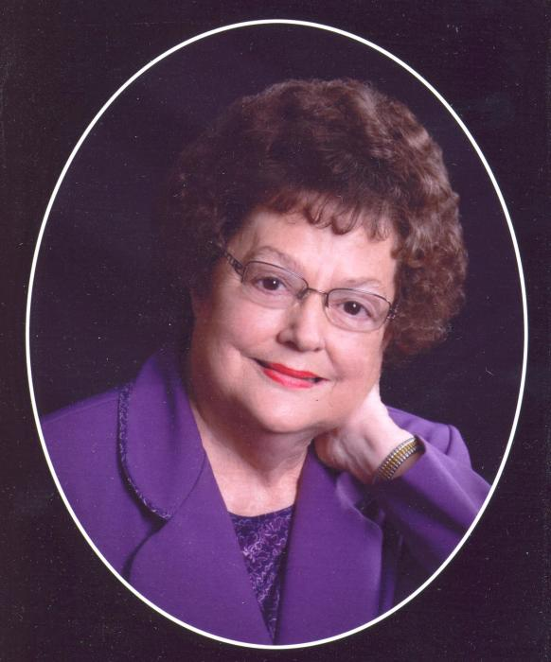
GRAHAM, TEXAS
ANNE RATCLIFF
NOVEMBER 1939 TO DECEMBER 2018
MEMBER OF THE ADDC AND
GRAHAM CLUB FOR 20 YEARS
FORMER MEMBER OF REGION IV

Slide 8
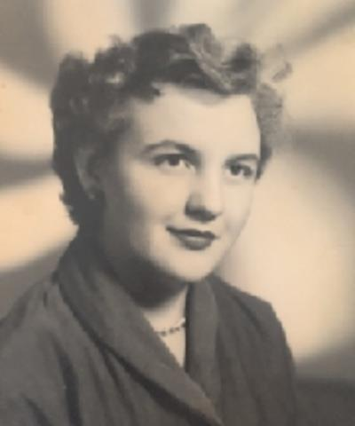
DALLAS CLUB
DOROTHY LYLE
NOVEMBER 1939 TO DECEMBER 2018
MEMBER OF THE ADDC AND
DALLAS CLUB
FORMER MEMBER OF REGION IV

Slide 9
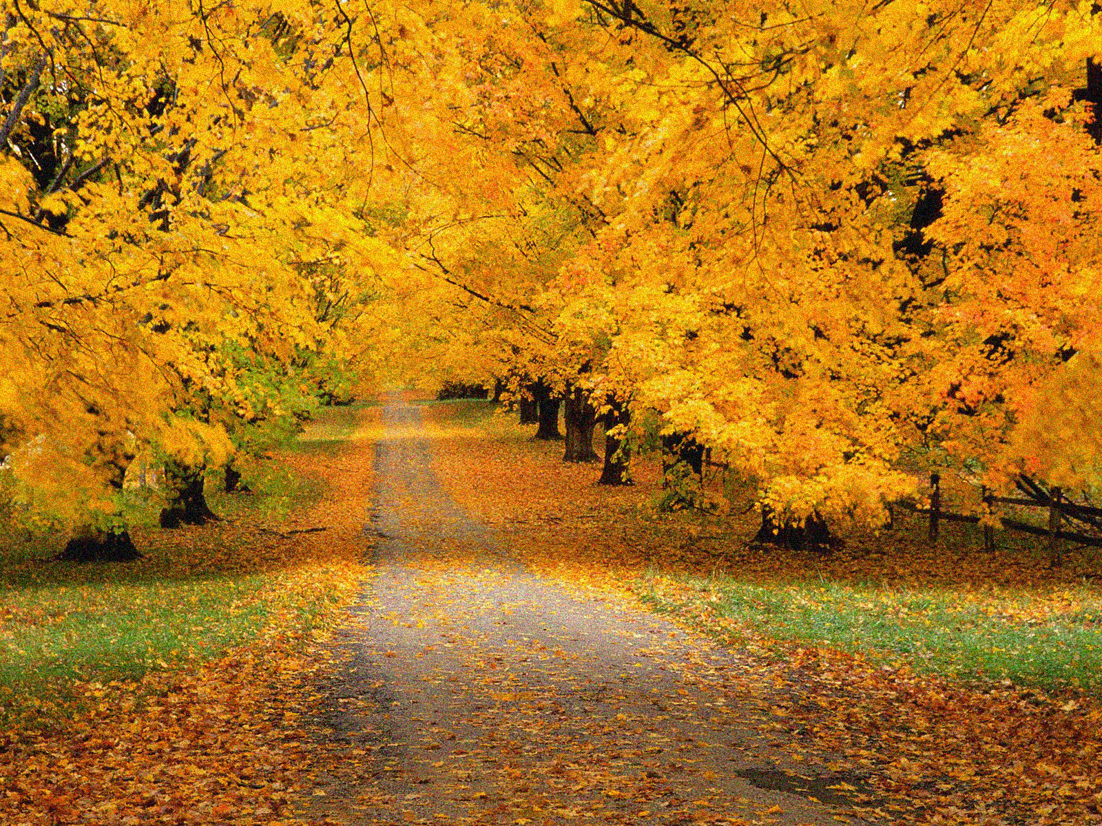
NORTHEAST REGION
This Photo by Unknown Author is licensed under CC BY-NC-ND

Slide 10
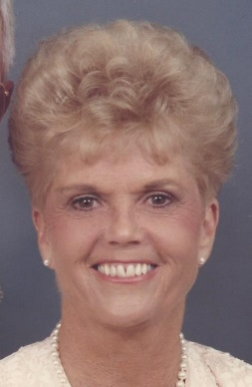
FAIRFIELD, ILLINOIS
NORMA JEAN DONNAY
AUGUST 1932 TO MARCH 2019
MEMBER TRI – STATE CLUB
REGION II DIRECTOR IN 1988 & 2000
FORMER MEMBER OF REGION II

Slide 11
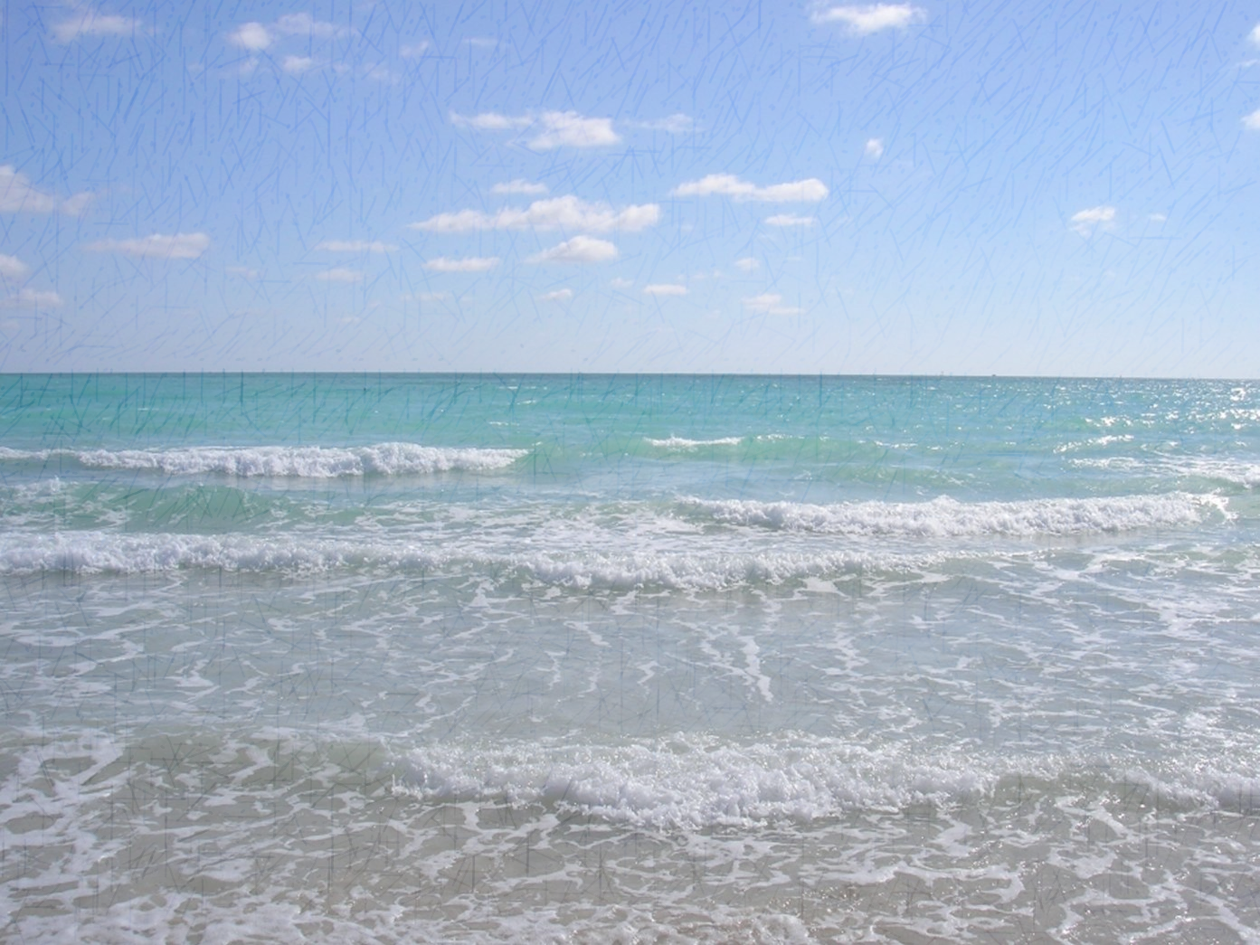
SOUTHEAST REGION
This Photo by Unknown Author is licensed under CC BY-SA

Slide 12
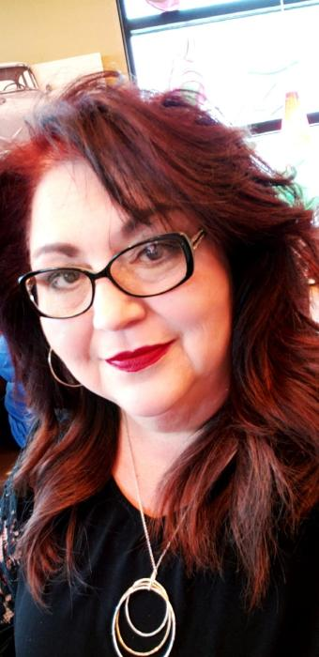
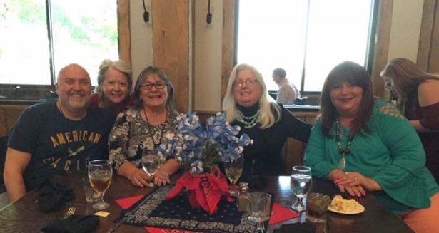
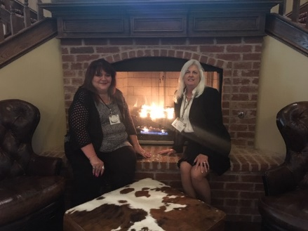
CORPUS CHRISTI, TEXAS
JANIE TORRES
NOVEMBER 1964 TO MARCH 2019
MEMBER OF CORPUS CHRISTI CLUB FORMER MEMBER OF REGION IV

Slide 13
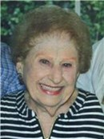
NEW ORLEANS, LOUISIANA
CARMELA SERIO JENNINGS
JULY 1921 TO OCTOBER 2018
MEMBER OF NEW ORLEANS CLUB FOR 51 YEARS.
FORMER MEMBER OF REGION III

Slide 14
NEDERLAND, TEXAS
LURL ANDRUS
JANUARY 1926 TO APRIL 2019
50 YEAR MEMBER OF NORTH HARRIS / MONTGOMERY COUNTIES CLUB
JOINED WASHINGTON DC CLUB IN 1968
REGION I DIRECTOR IN 1974
ADDC PRESIDENT IN 1980
FORMER MEMBER OF REGION IV

Slide 15
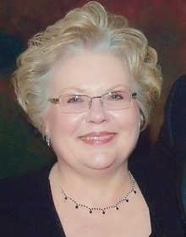
SAN ANTONIO, TEXAS
LOIS MARIE DOWNS
SEPTEMBER 1948 TO OCTOBER 2018
MEMBER SAN ANTONIO CLUB
JOINED IN 1986
FORMER MEMBER OF REGION IV

Slide 16
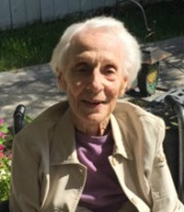
VICTORIA, TEXAS
MARIE GUMMELT
MARCH 1923 TO JULY 2019
MEMBER OF VICTORIA CLUB
JOINED IN 1955
REGION IV DIRECTOR IN 1979
FORMER MEMBER OF REGION IV

Slide 17
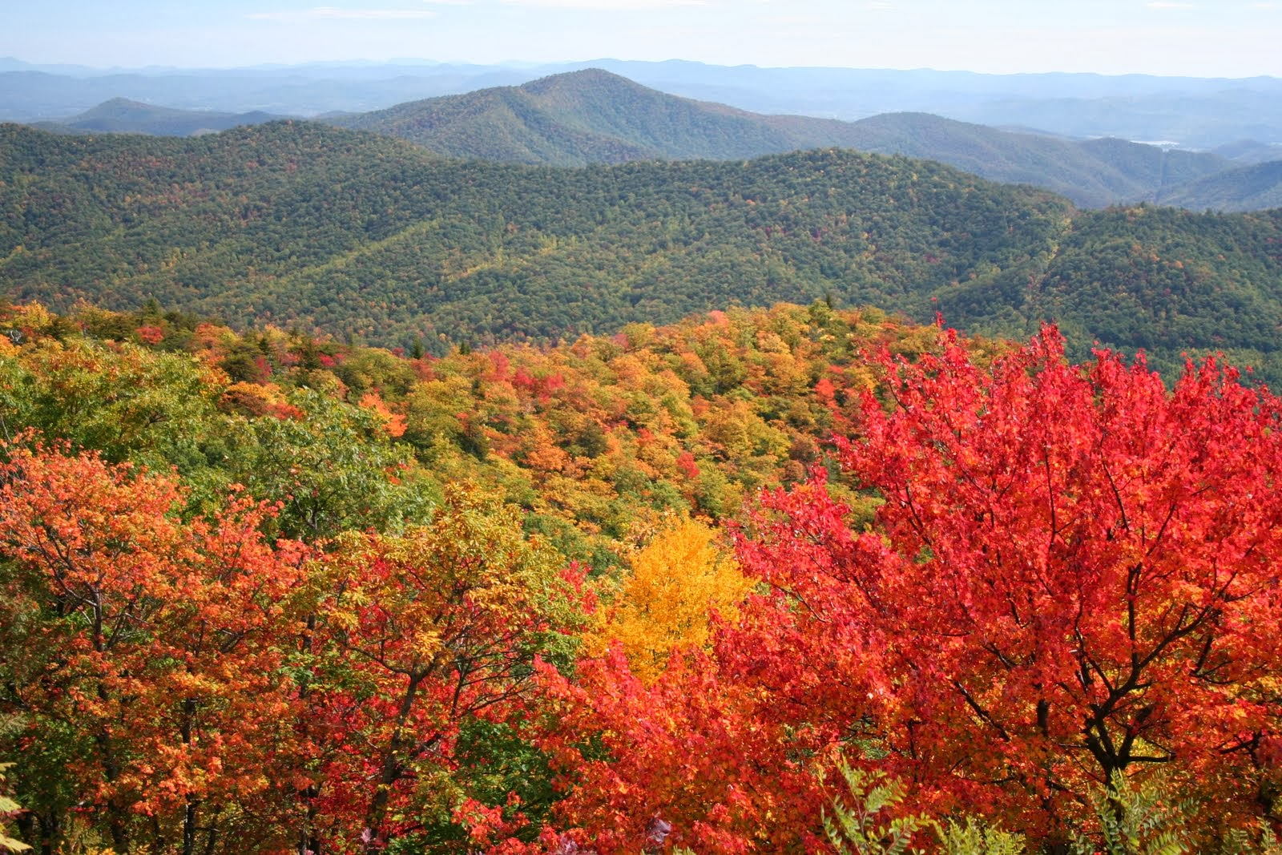
WEST REGION
This Photo by Unknown Author is licensed under CC BY-NC-ND

Slide 18
MIDLAND, TEXAS
MAGARET (MAGGIE) SNELLING
FEBRUARY 1927 TO APRIL 2019
MEMBER OF MIDLAND CLUB
JOINED IN 1980
FORMER MEMBER OF REGION V

Slide 19
MIDLAND, TEXAS
DEANNA CAROL WAUHOB
JUNE 1949 TO AUGUST 2019
MEMBER OF MIDLAND CLUB
FORMER MEMBER OF REGION V

